Slide 1

Automatic Comments Generation
Sai Pranathi Chitikeshi (G01388673)
Sai Sucharitha Ginjupalli (G01328384)
Sanjana Vatsavai (G01371785)

Slide 2
Challenges
The process of manually commenting code in software development has many challenges that make projects less efficient and more difficult to maintain. Some of the main problems include incorrect comments, the time it takes to manually comment, insufficient documentation, and difficulties in providing useful context. To address these issues, a new system has been proposed that utilizes advanced technologies like Large Language Models (LLMs) to automate the code commenting process. This automation will help overcome the mentioned challenges.

Slide 3

Challenges Addressed
Difficulty in efficiently generating insightful code comments.
Accurate code analysis and informative comment generation.
Ensuring intelligent understanding of the context within the code snippets.
The complexity of optimizing Large Language Models (LLMs) for coding tasks
Ensuring a seamless interaction between developers and the tool

Slide 4

Challenges Resolved By The Tool
By using advanced Large Language Models (LLMs) such as ChatGPT specific coding tasks can be performed, and they can understand code snippets and automatically produce useful comments.
By using advanced Natural Language Processing (NLP) methods that allow for a thorough analysis of code snippets, we were able to make it understand the code and generate comments by taking the variable names, methods, etc… This ensures that the comments generated by the tool are meaningful within the given context.
The tool effectively addresses this challenge by continuously refining LLMs. By making ongoing adjustments based on data and user feedback, the tool ensures that the LLMs are optimized to produce precise and contextually appropriate comments.
The user-friendly interface makes it easy for developers to interact with the tool and have control over the documentation process.

Slide 5
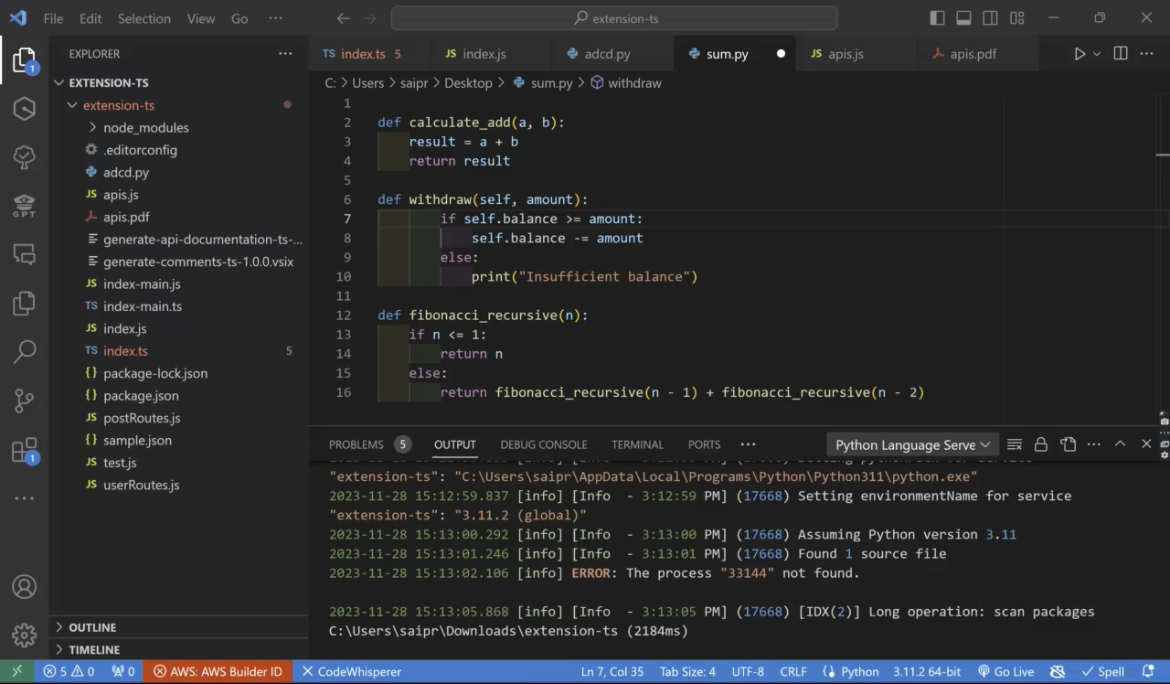
demo

Slide 6
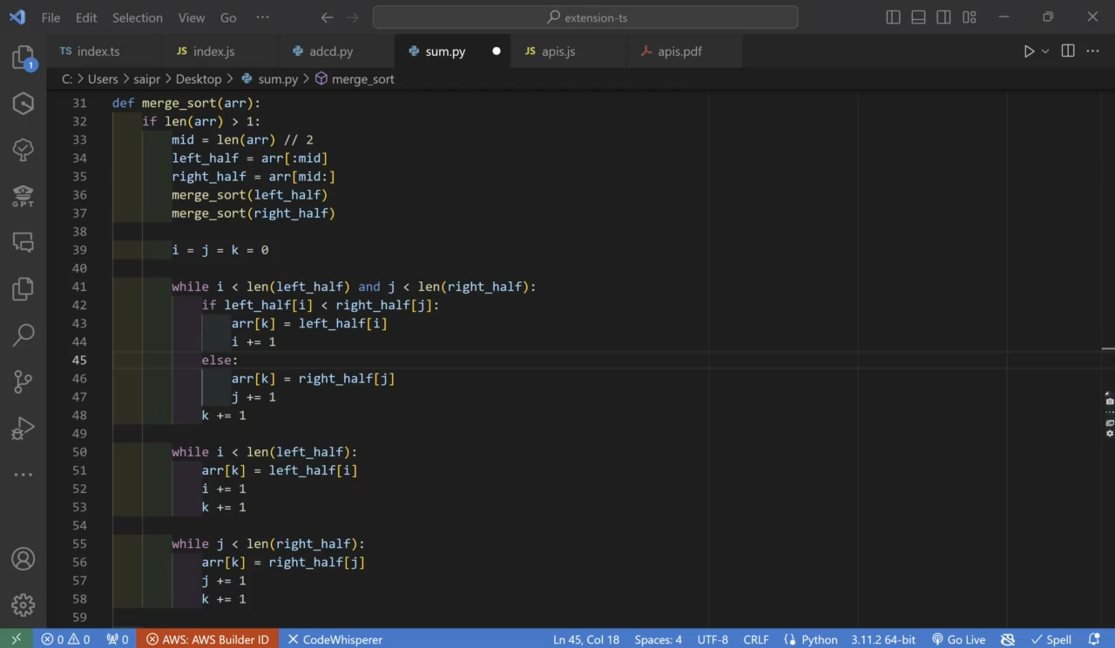
demo

Slide 7
Pros
As the comments are generated using the LLM they are more accurate.
The tool's user-friendly design made it simple for developers to navigate and modify comments effortlessly.
The customization option allowed developers to adjust comments according to their style and specific project needs, giving them more control.
The tool demonstrated a strong ability to understand the context within code snippets, contributing to the relevance and accuracy of generated comments.
the tool efficiently automated the commenting process, contributing to increased development speed.

Slide 8
cons
We need to select the code before applying our extension which can be tedious for large projects.
When considering many methods, the comments will be generated at the start of all the selections and not near the exact method, which can be a hard task for a programmer.
The tool faced limitations in generating precise comments for complex code structures.
The tool exhibited challenges in handling certain edge cases, leading to less appropriate or potentially misleading comments.
Some comments generated were technically accurate but these comments occasionally failed to provide the depth of information desired by developers for a thorough understanding.

Slide 9


